Slide 1

Fellowship of the Heart
Getting Started — the Four Connects, walked around the table on alternating evenings
Evening Series 2026–27 · at the Tittle home · v1.5E DRAFT
All Scripture: ESV · The Companion lesson plans carry the full scripts — these slides carry the room
C1
Notes:
DECK TITLE · pre-session · DIVIDER
On screen as the room assembles on night one. All Scripture ESV; the plans carry the scripts; these slides carry the room — and these notes carry you.

Slide 2

SESSION 3–4
Telling Your Story — I & II in One Evening
One question, one circle, everyone tells — the current-condition form for a room that knows each other
Quarter 1: Connect with Self & Others
C2
Notes:
S3–4 COMBINED · pre-session · DIVIDER
On screen through dinner and as the circle forms. Greet at the door — the slide holds the room.

Slide 3




Where We Are — the Four Connects
Session 3–4 combined crosses from the first box toward the second — Self opening toward Others — everyone tells tonight, teen-led. Each connection makes the next one real (Matt. 22:37–40).
C3
Notes:
S3–4 COMBINED · WELCOME · LEAD: CONTAINER HOLDER · GROUNDING — every session opens on this map
BEATS:
1. Locate tonight on the map, plainly: Session 3–4 combined crosses from the first box toward the second — Self opening toward Others — and everyone tells tonight, teen-led.
2. The four boxes are one journey — each connection makes the next one real — rooted in the two great commandments: love God, love neighbor (Matt 22:37–40).
3. This is also the 'where we are on the map' minute the welcome owes any newcomer.
CUES: Two minutes at most; then tonight's road.

Slide 4

Session 3–4 — Tonight’s Road
1 Welcome and centering
2 Check-in — the homework practice since we last met
3 Psalm 139 — being known
4 The form, reminded
5 The telling circle — everyone tells
6 One-word landing
7 Homework commissioning — handout + check-in partners
8 The Leader Feedback Round — both leaders
9 Closing container
C4
Notes:
S3–4 COMBINED · 7:00–8:30 · LEAD: BOTH LEADERS
BEATS:
1. STILL the highest-risk material of the series — Handbook Section 6 re-read within 48 hours before; crisis card in every Companion pocket; pastoral/clinical backup on call 6:30–11:00.
2. Shape: open, check-in, Psalm 139, the form reminded, one-circle telling (everyone, ~50 minutes), landing, Joint Footprints, feedback, close.
3. The current-condition form: this room knows each other; the teens lead throughout. The two-session form (parents' night, then the teens' night, with splits) is held in reserve for a larger room of newer people.
4. The clock is a guide — if a block runs long because something true is being said, let it; the compression lever is one-sentence blessings.
CUES: Telling order arranged beforehand — Companion-first stays available as a depth-setting lever when the circle needs it. Any parent whose story carries news their teen has not been handed talked with the Lead Companion first — hold that plan.

Slide 5
Opening Container — the Eight Steps
1 Welcome — five minutes to open the container
2 Phones silenced and put away
3 Stand in a circle
4 One-word check-in — how you actually are, right now
5 Put out / bring in — set something down; bring a blessing in
6 Spoken commitment: “I am here. I am paying attention. I am willing to be moved.”
7 Opening prayer — “Holy Spirit, you are welcome here. Speak. We are listening.”
8 Sit. Begin.
C5
Notes:
S3–4 COMBINED · 7:00–7:06 · LEAD: CONTAINER HOLDER
BEATS:
1. A Companion-in-Formation opens the night: blessing, container, the frame — the pieces are required, their own words are fine.
2. Frame plainly: tonight completes the round in one evening — parents and teens both tell.
3. Container reminders: Safe, Present, Clear, Intentional; nothing is required; we listen and bless, we do not fix.
CUES: Spot anyone who arrived heavy — eye contact, smile, no singling out. They will know you saw them.
PAIR LEAD: name the leading pair in the welcome — two leaders hold tonight, and the room will see the evening handed back and forth between them; that is the design. The pair practices the session together beforehand.

Slide 6

Week 2 Check-In — Heart Soil
• “Some of you journaled this week. Some of you didn’t. Both are fine.”
• One sentence about what showed up — optional, no pressure
– “‘Path soil at school’ — just one sentence. Anyone?”
• “The work is happening, whether or not we name it tonight.”
C6
Notes:
S3–4 COMBINED · 7:06–7:12 · LEAD: CONTAINER HOLDER
BEATS:
1. Six minutes, one sentence each on what the homework practice surfaced since we last met; a parent starts.
2. Call on no one; silence is fine — 'the work is happening, whether or not we name it tonight.'
GUARD: Keep it light and brief — the evening's weight is in the telling circle.

Slide 7
Psalm 139 — Being Known
• Psalm 139 is the psalm of being completely known by God — and the psalmist’s response is not panic. It is wonder
• Most of us have parts we hope nobody has noticed. The psalmist invites God to look further
• The opposite of being hidden is not being exposed — it is being seen and being safe at the same time. That is what the circle is
• Tonight is the practice of it — everyone answers one question, with what they are willing to say
• Every story is its own — put the comparison down. The story you tell tonight is not in competition with any story told before it. Tell yours
PSALM 139:23–24
“Search me, O God, and know my heart! Try me and know my thoughts! And see if there be any grievous way in me, and lead me in the way everlasting!”
C7
Notes:
S3–4 COMBINED · 7:12–7:20 · LEAD: CONTENT PRESENTER
BEATS:
1. Read Psalm 139:1–6, then 23–24, from the physical Bible. Slowly. Do not preach over the reading.
2. The psalmist is completely known and not running — his response is wonder, and he invites more: 'Search me.'
3. Land the one idea: the opposite of hidden is not exposed — it is seen and safe at the same time. That is what the circle is.
4. Say the comparison word out loud: every story is its own; nobody's telling sets a bar for anyone else's.
5. Tonight is the practice of it: everyone answers one question at the depth they choose; the circle blesses, never fixes.

Slide 8
The Form, Reminded
• The one question: “tell the story of how you got here — today, as you are. What has shaped you into who you are today?”
• Be specific — not the hero, not the victim: what happened, and where you see God in it now, looking back
• This room has seen the form — tonight is a reminder, not a demo. A leader may model briefly if the room needs it
• The depth is yours to choose. Every story is its own — no comparing, no bar to clear
C8
Notes:
S3–4 COMBINED · 7:20–7:23 · LEAD: CONTENT PRESENTER
BEATS:
1. Remind the form in one breath: one question — how you got here and what has shaped you; specific; neither hero nor victim; where you see God in it now.
2. This room has heard the demo — do not re-teach it. If anyone new is present, the Lead Companion models three minutes, practiced in advance.
3. Name the comparison guard from the start: every story is its own; nobody's telling sets a bar.
GUARD: Three minutes. The telling circle needs its full fifty.

Slide 9
The Telling Circle — How It Works
1 One question — how you got here, and what has shaped you. The depth is yours to choose
2 Listening — do not fix. Do not advise. Do not say “that happened to me too.” Receive, then bless
3 Nothing leaves this circle. “Not a phrase, not a name, not a story.”
• One circle — at this table, everyone tells tonight: parents and teens, five to six minutes each
• After each story: ten seconds of silence, then a short blessing round
C9
Notes:
S3–4 COMBINED · 7:23–7:25 · LEAD: CONTENT PRESENTER · TRANSITION
BEATS:
1. The three rules, briefly: one question, depth is the teller's; receive then bless — no fixing, advising, or 'me too'; nothing leaves the circle.
2. Pray the bridge prayer: 'Make this circle a small place where we can be known and safe at the same time.'
3. No split at this scale — one circle, right where we sit.
CUES: Order arranged beforehand: a leader tells first, then the arranged parent, then around — each teen's arranged parent blesses first after that teen's story.

Slide 10

The Telling Circle — Everyone Tells
• Everyone tells tonight — parents and teens, one round, the completion in one evening
1 Story — 5–6 minutes. The teller speaks; nobody interrupts, even the silences
2 Silence — ten seconds
3 Blessing round — one or two sentences each: “What I want to bless about your story is...”
• Parents: receive the teens without correcting the record or filling silences — the telling stands
• “When someone is telling their story, we are looking at them. We are receiving. That’s the practice.”
C10
Notes:
S3–4 COMBINED · 7:25–8:13 · LEAD: CONTENT PRESENTER · ONE CIRCLE
BEATS:
1. A leader tells first, then the arranged parent, then around the circle — teens choose their own moment within the round; a pass is re-offered at the end.
2. 5–6 minutes per story; at six, gentle eye contact — 'let's land it together.' Ten seconds of silence; then the blessing round — the arranged parent blesses first after each teen's story.
3. Parents receive teens without correcting the record, filling silences, or bracing — the teen's telling stands.
4. Short on time: compress blessings to one sentence each. Never send anyone home untold.
GUARD: Section 6 stands in full — this is still the series' highest-risk material. Watch each teen during their parent's telling and each parent during their teen's; anything heavy hands to the backstop adult. Crisis card in pocket; backup on call.

Slide 11
One-Word Landing — the Round Complete
• What happened in your circle stays in your circle
• One word — just one — about what tonight was like for you. You can pass
– “Heavy.” “Seen.” “Surprising.” “Tender.” “Hard.” Whatever the true word is
• “The round is complete — every person in this room, parent and teen, has told a piece of their story to a circle that blessed them for it. Rooms like this are rare. They’re the kind of room God shows up in.”
C11
Notes:
S3–4 COMBINED · 8:13–8:18 · LEAD: CONTAINER HOLDER
BEATS:
1. Let the room settle; the texture will be different — honor it, do not break it with energy.
2. One word each on what tonight was like; pass allowed. Receive with eye contact and a small nod — no 'great', no commentary.
3. Name the completion: every person, parent and teen, told and was blessed — in one evening. 'Rooms like this are rare. They're the kind of room God shows up in.'
GUARD: Do not ask anyone to share story content — the tellings stay in the circle.

Slide 12

Homework — Two Weeks, Four Parts — Joint Footprints
• Joint Footprints — each parent-and-teen pair sits together once this week. Twenty minutes total
• Not in the car, not at dinner, not while the TV is on. Phones away
1 Five minutes telling the footprints question — where you grew up, who shaped you, what places and people made you who you are
2 The listener asks one or two follow-ups, then one sentence: “What I love about your footprints is...”
3 Then swap — the other person tells, the first listens and blesses
• The morning question and evening journal note continue daily
C12
Notes:
S3–4 COMBINED · 8:18–8:22 · LEAD: CONTENT PRESENTER
BEATS:
1. Parent Co-Companion leads. One handout per family (H3.5 — the Session 3 sheet).
2. The practice: parent and teen sit together twenty minutes this week — not the car, not the TV, phones away. Five minutes of footprints each way; a follow-up or two; then one sentence: 'What I love about your footprints is...'
3. Two rules: each shares only what they are ready to; the parent does not turn it into a lecture.

Slide 13
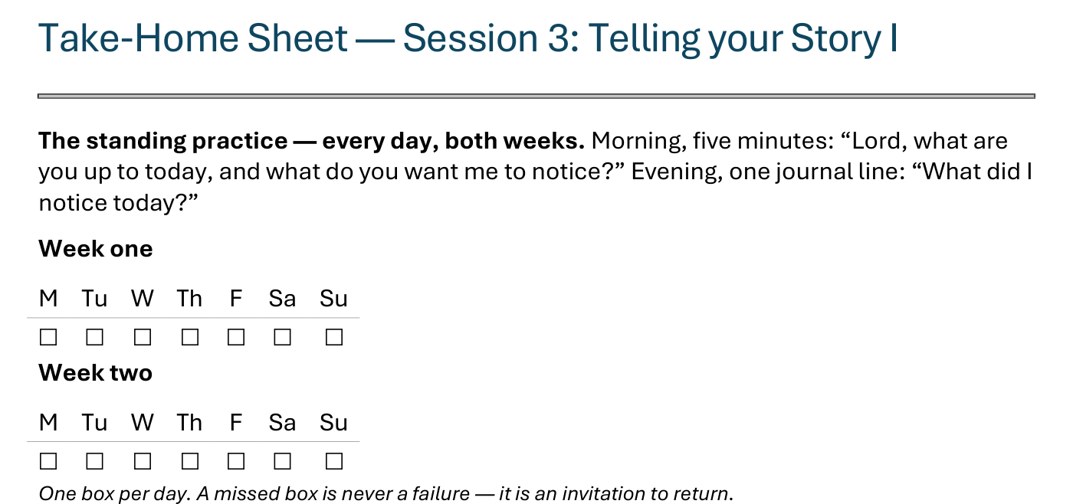
The Take-Home Sheet — the Daily Rhythm
Handed out now — this is the sheet in your hands.
C13
Notes:
S3 · COMMISSIONING · LEAD: CONTENT PRESENTER
BEATS:
1. The sheet on the screen is the sheet in their hands — walk it, don't read it.
2. The standing rhythm first: the morning question, the evening journal line — one box per day on the week-grids.
3. A missed box is never a failure — it is an invitation to return.
CUES: The four parts are the next slide.

Slide 14
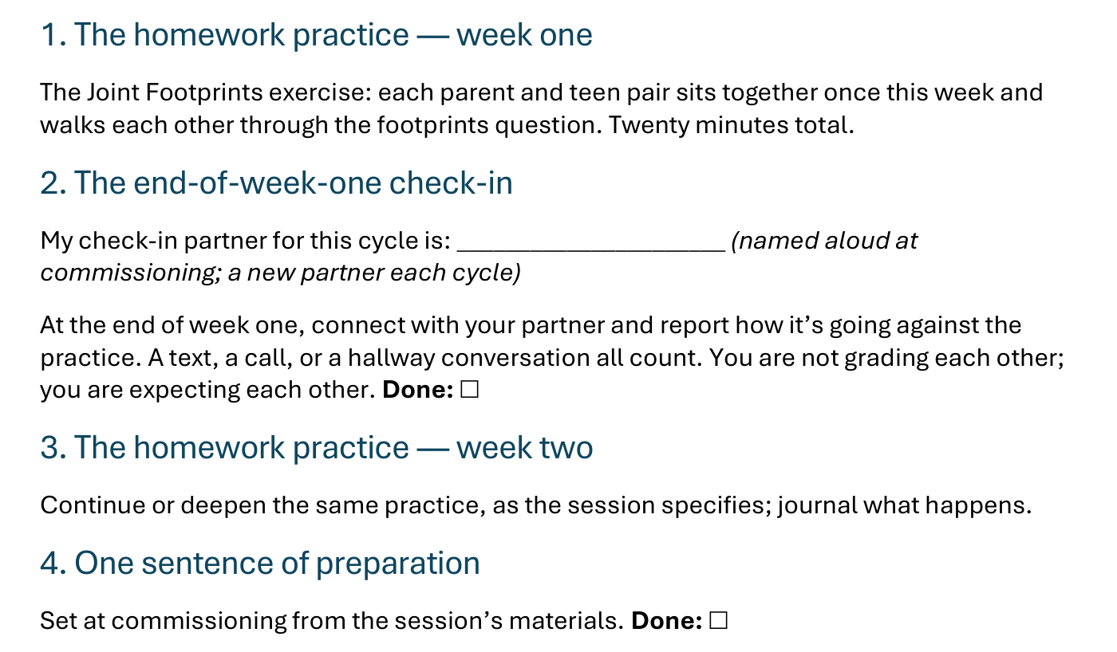
The Take-Home Sheet — the Four Parts
One practice at a time — and a partner expecting you at the end of week one.
C14
Notes:
S3 · COMMISSIONING · LEAD: CONTENT PRESENTER
BEATS:
1. The four parts, in order: the homework practice, week one; the end-of-week-one check-in; the homework practice, week two; one sentence of preparation.
2. Check-in partners are named aloud before leaving this slide — the sheet has the line to write the name.
GUARD: The sheet-walk, not a re-teach.

Slide 15

The Leader Feedback Round
• Two rounds, same as every session — the container holder first, then the content presenter: three things each
– “What I think went well tonight: ______”
– “What I’d do differently next time: ______”
– “If I were to teach tonight’s process to someone, I would tell them: ______”
• Then the room — the same two questions about tonight
• The leaders receive without defending — “thank you” is the whole response
C15
Notes:
S3–4 COMBINED · 8:22–8:26 · LEAD: BOTH LEADERS
BEATS:
1. If a senior led tonight, they answer the three things first, the adult second; the room's feedback covers both.
2. Keep the room's words specific and for-you-shaped — 'the way you waited out the silence' is gold; 'you did great' is not.
3. Receive without defending — 'thank you' is the whole response.

Slide 16
Closing the Container + Aaronic Blessing
• We close the way we opened — the container, six steps:
1 Stand again — same circle, same posture as the open
2 One-word landing — compare it to your opening word
3 The one thing you are taking from tonight
4 The one practice — committed aloud, or modified to one you will actually keep
5 Blessings — eyes on the person, not the screen: say what is on your heart for them. Specific, witnessed, short
6 Closing prayer — and the Aaronic blessing, spoken over each other, face to face
THE AARONIC BLESSING — NUMBERS 6:24–26
“The Lord bless you and keep you;
the Lord make his face to shine upon you, and be gracious to you;
the Lord lift up his countenance upon you, and give you peace.”
C16
Notes:
S3–4 COMBINED · 8:26–8:30 · LEAD: CONTAINER HOLDER
BEATS:
1. Restate the container hard: your own story goes home with you; nobody else's does — not to a sibling, a friend, or a spouse not in this room.
2. Name the help: reach out if tonight sits heavy — email, text, knock; the Crisis Quick-Reference Card is real and someone is there.
3. Aaronic blessing. 'Go gently this week.'
CUES: Do not pack up — adults stay accessible ten minutes after. Find any senior who led before they leave: one sentence of thanks, and 'How are you, after that?'
BLESSINGS: eyes on the person, not the screen — nothing to read; say what is on your heart for them, specific and short.

